Slide 1




Pivotal Cloud Foundry
Services Overview

Slide 2
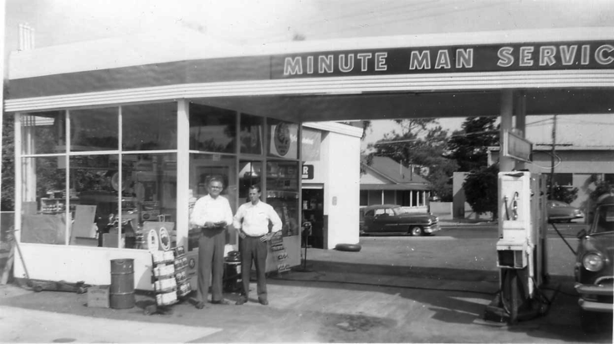
What is a Service
Allows resources to be easily provisioned on-demand, via self service APIs
Typically middleware, frameworks, and other “components” necessary for applications (e.g., Database, Message Queue, etc.)
Can be a persistent, stateful layer

Slide 3

Three Types of Services
Managed - Fully integrated, with full lifecycle management
Brokered – Uses a service broker but is external to the platform
User-Provided – Created and managed external to the platform

Slide 4





A Multi-Cloud Platform: Cloud Foundry
Jenkins Service
(CI)
Elastic
Container
Runtime
Agile Microservices
Redis
MySQL
Rabbit MQ
DataStax
Cassandra
Elastic managed runtime service integrated into leading data services; all scaled and managed by CF BOSH
Cloud Foundry BOSH
Multi-Cloud Declarative Service Deployment, Operations
Azure
Notes:
Here we have a birds eye view of PCF
-- Deployed over your favorite IaaS solution is our Elastic Runtime – a set of microservices that defines PCF
-- Several application services are integrated into the platform like Jenkins, Messaging, Caching, Hadoop, etc, the list is always growing!
-- The deployment is managed by OSS Cloud Foundry BOSH which we simplify via Ops Manager, a web based management interface
----
When I can, I like to whiteboard this picture – interactive.
Start with the elastic runtime
Managed by BOSH
IaaS agnostic
Other services/clusters managed by BOSH – KV Store, … and even partners, i.e. Jenkins.

Slide 5
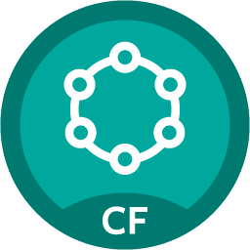
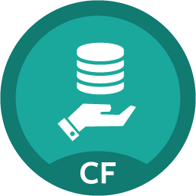
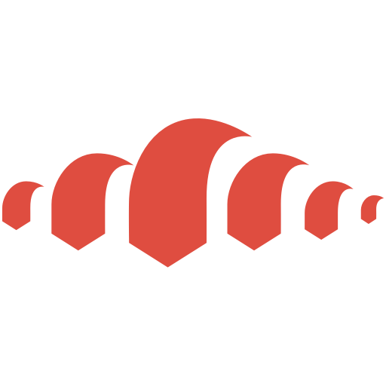
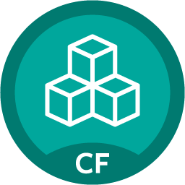


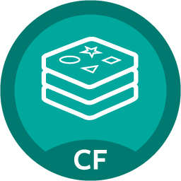

PCF – Functional Architecture
Single Platform and API for multiple Cloud Native workloads
API
Logs and Metrics
Routing
Buildpacks
PCF System Components
Common API
Partner
Services
Pivotal
Services
Garden Linux
Garden Windows
Notes:
After years of collaboration w/ MSFT and CF community
.NET apps are going to be first class citizens in Cloud Foundry
Same “cf push” experience with support for “day 2“ Operations – log aggregation, HA, scaling etc
Almost any .NET application will run as long as architectural principles of 12 factors/cloud native architecture are followed
Provides Windows containers with fast startup & high app density per host
Also Docker support is now beta with 1.6 (graduated from “experimental”)
Diego only supports secure registries bearing certificates signed by a common CA. Support for self-signed certs or custom-ca certs will be introduced in a subsequent release.
Day 2 Ops better w/ Enhanced Runtime – faster scaling, faster self healing, run highly elastic workloads at scale.
Security features
Operators can enforce secure traffic to the network edge of the platform in order to reduce the vulnerability of each application’s data in flight.
PCF Operators can enforce secure connections from their load balancers to the VMs on which the CF routers run, whereas before that termination happened at the load balancer. This improves the security of the traffic between applications and clients.
Ensures that a default CF installation doesn’t contain insecure or unsupported versions of application runtimes

Slide 6
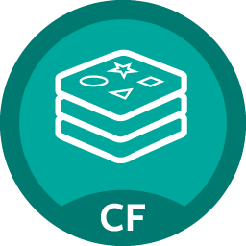
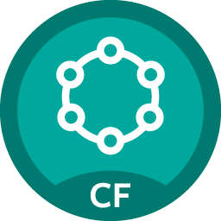
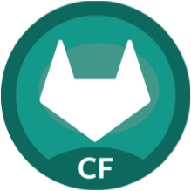
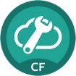
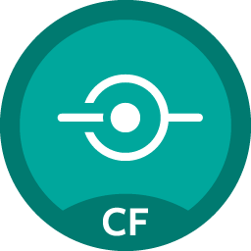
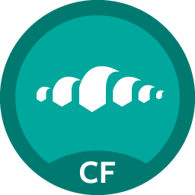
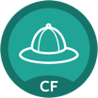
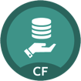
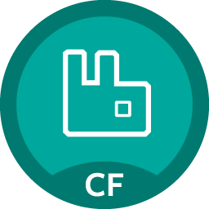
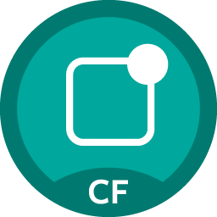

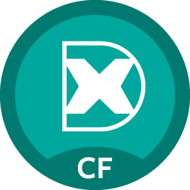
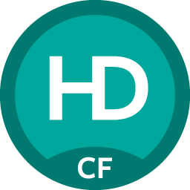
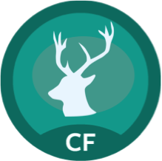

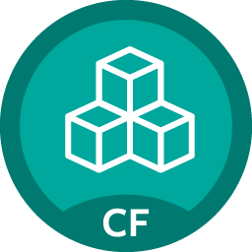

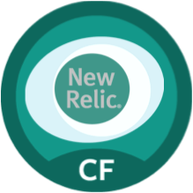

Pivotal Cloud Foundry Services
Mobile
Data
CI/CD
Cloud Native
DataStax Cassandra
Config Server
App
Distribution
Redis
Git Lab
Jenkins Enterprise
Service Directory
Push Notifications
MySQL
RabbitMQ
Monitoring
Circuit Breaker
Security
Data Flow
PivotalHD
App Dynamics
Single Sign-on
Session state caching
GemFire
Powered by
New Relic

Slide 7


D e m o
Notes:
Marketplace Walkthrough (if not done yet)
Network.pivotal.io walkthrough to show the services and how to download tiles as Operator

Slide 8
Service Broker
Flexible, RESTful API
Allows Service Authors to provide self-provisioning Services to developers
Create
Cloud Controller
Service Broker
Service Nodes
Bind
Connect
Cell
Apps

Slide 9
Creating and Binding a Service
Service
credentials
DB
CLI
create service (HTTP)
Cloud Controller
create service (HTTP)
Service
Broker
reserve resources
Data
Service
Router
bind service (HTTP)
bind service (HTTP)
obtain connection data
Pivotal Cloud Foundry
Elastic Runtime
Notes:
An application runs in a CELL, which is a droplet execution agent. The Cloud Controller orchestrates the routing and lifecycle of all DEAs in the pool. Routers manage application traffic. Health Manager reports mismatched application states to the CC. A service gateway provides an interface for services (native or external). A messaging bus manages all system communication. Apps are accessed directly through the router while web and CLI clients (e.g., vmc, STS) access Cloud Controller via RESTful services.

Slide 10

Pivotal Cloud Foundry Services
Operated ‘as a Service’
Configured and integrated to enable push button deployment
Full lifecycle management - software updates and patching
Bind to apps through an easy-to-use interface
Common view into access control and audit trails across a breadth of services
EASY
Notes:
In many organizations, provisioning of data and messaging services for applications can take weeks, if not months because of the number of teams, administrators and exchange of credentials involved. We are striving to address this problem by providing a common model for services deployment via Pivotal Cloud Foundry that developers can easily find and their applications bind to – and scale those services as needed.
PCF Services allow administrators to provide pre-defined database and middleware services, and this gives developers the ability to rapidly deploy a software product from a menu of options without the typical slow and manual provisioning process. This is also done in a consistent and supportable way. PCF Services are managed and operated ‘as a Service,’ and this means they are automatically configured upon request. The provisioning process also incorporates full lifecycle management support, like software updates and patching.
This automation removes the overhead from developers, who are often saddled with service configuration responsibility. It makes administrators’ lives easier and addresses security risks by standardizing how services are configured and used.

Slide 11
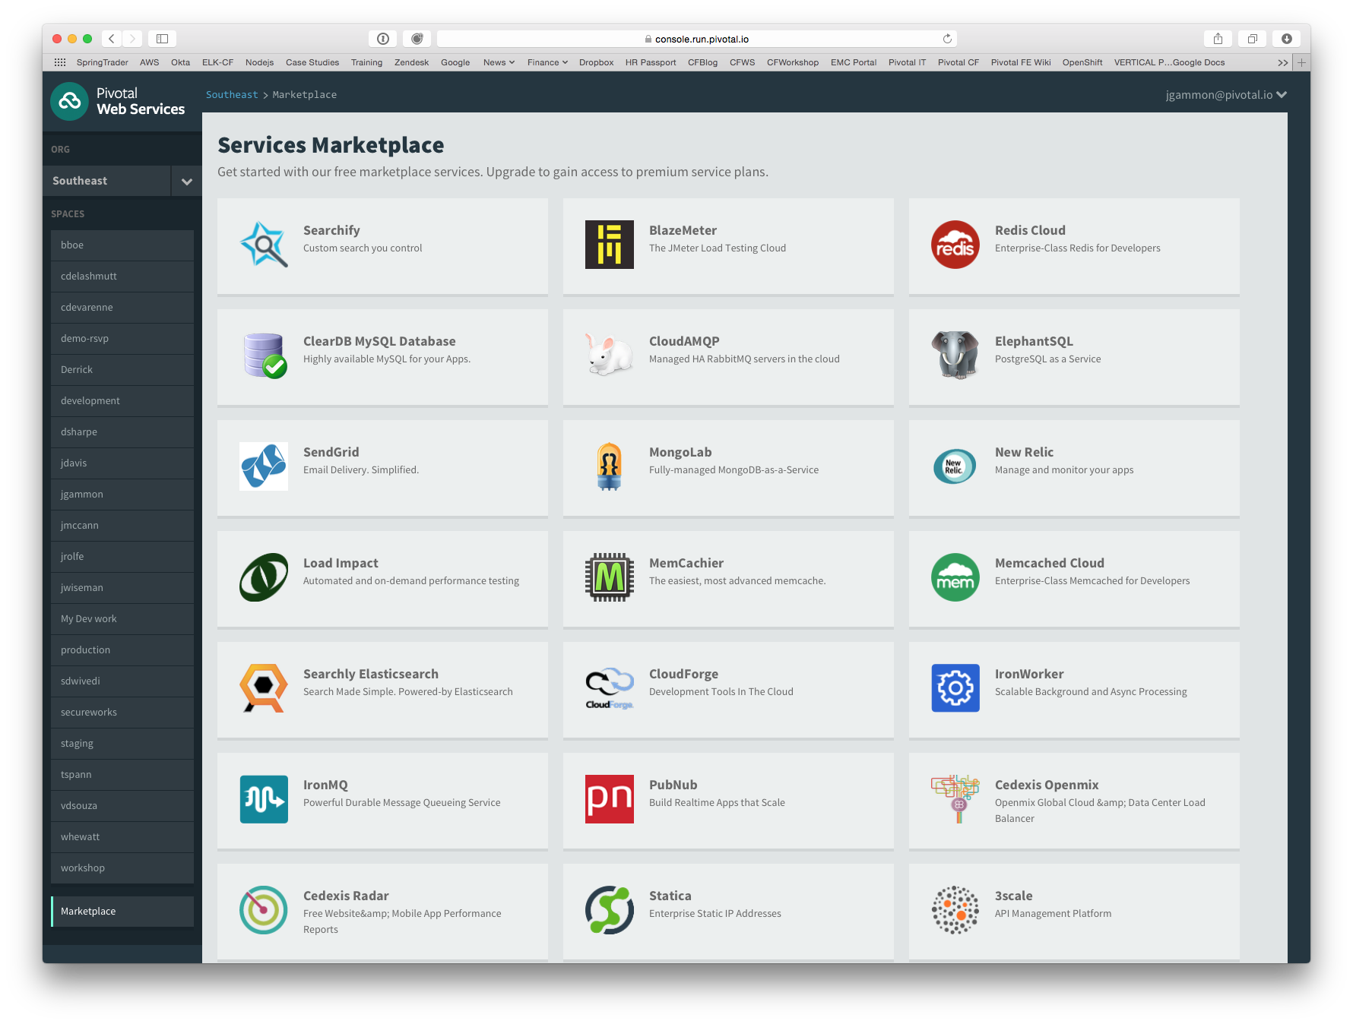
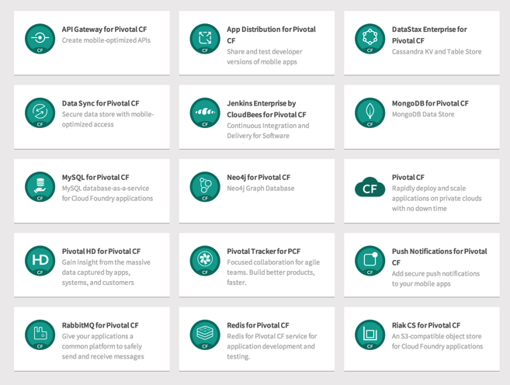
PCF Marketplace
Broad Services Ecosystem
Easy accessibility
Quick, self-provisioning

Slide 12
Route Services – Use Case
Cloud Foundry users want applications to be able to opt in to various types of filters and content transformations for their application. (Called Route Services)
Use Case:
Rate Limiting
Metering
Caching
Logging

Slide 13
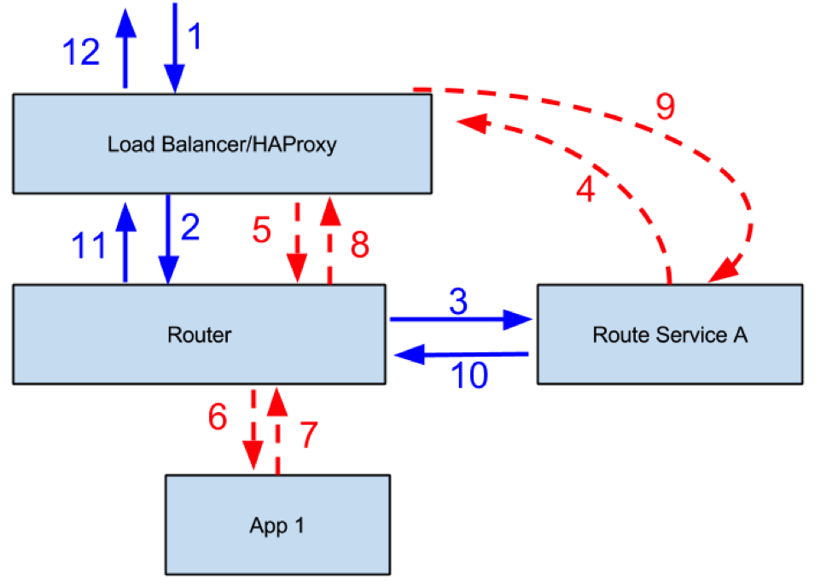
PCF – Route Services
Route Service would need a name, a URL and a space.
Could be running as an App in CF or as a external service
A space developer can define the
route service and can bind/unbind the route service to an app.

Slide 14
PCF – APIGEE Integration
Customers who want to use an API gateway in front of their PCF hosted apps for rate management, security, payload translation/modification, API monetization, or to access back end services through a RESTful interface.
Use Case:
Use of API Proxy
Audit
Analytics
Reporting

Slide 15
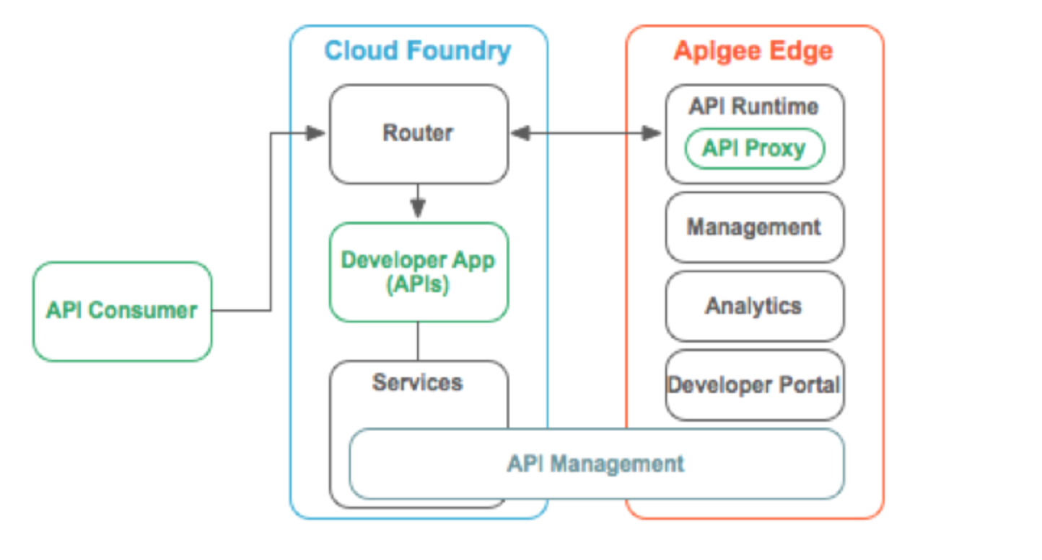
PCF – APIGEE Integration

Slide 16




Diversity of clients, more load
In January 2014, mobile devices accounted for 55% of Internet usage in the United States. Apps made up 47% of Internet traffic and 8% of traffic came from mobile browsers.
http://money.cnn.com/2014/02/28/technology/mobile/mobile-apps-internet/
Notes:
When we established the predominant enterprise architecture paradigms, the vast majority of our clients were usually tethered to a desk with a workstation. Now that has flipped…

Slide 17
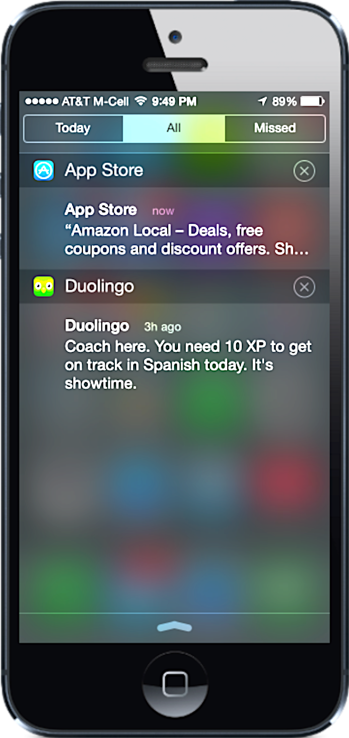
Push Notifications
Problem
Push is difficult to implement across platforms and at scale
Most existing push solutions are public / shared
Data owned by SaaS provider and cannot be fully leveraged by enterprise
Difficult to integrate SaaS push providers with services behind the firewall
Solution / Benefits
Dedicated, comprehensive solution built to scale
Full control of data and comprehensive logging / tracing
Direct integration with enterprise services

Slide 18
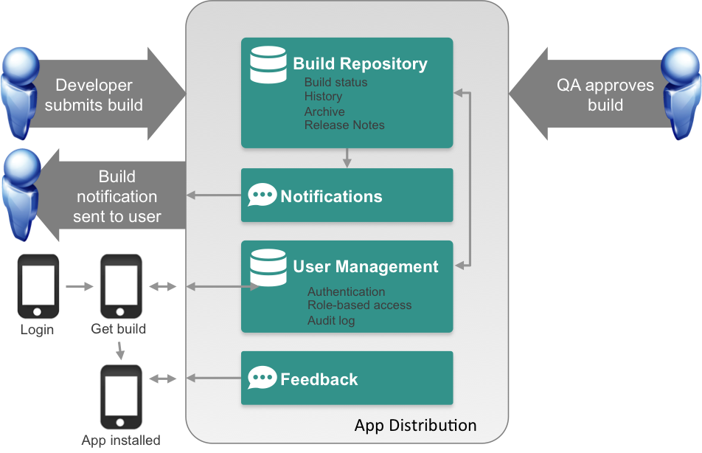
App Distribution
Problem
Extensive user testing of apps is critical to success
Difficult to distribute pre-release apps to test users
Existing solutions are public cloud
Solution / Benefits
Easy OTA app distribution
User / team management
Supports all major platforms
Private cloud for management

